Slide 1
Introduction:
Direct Memory Access (DMA) is a method of allowing data to be moved from one location to another in a computer without intervention from the central processor (CPU).
It is also a fast way of transferring data within (and sometimes between) computer.
The DMA I/O technique provides direct access to the memory while the microprocessor is temporarily disabled.
The DMA controller temporarily borrows the address bus, data bus and control bus from the microprocessor and transfers the data directly from the external devices to a series of memory locations (and vice versa).

Slide 2
Basic DMA Operation:
Two control signals are used to request and acknowledge a direct memory access (DMA) transfer in the microprocessor-based system.
The HOLD signal as an input(to the processor) is used to request a DMA action.
The HLDA signal as an output that acknowledges the DMA action.
When the processor recognizes the hold, it stops its execution and enters hold cycles.

Slide 3
Cont.,
HOLD input has higher priority than INTR or NMI.
The only microprocessor pin that has a higher priority than a HOLD is the RESET pin.
HLDA becomes active to indicate that the processor has placed its buses at high-impedance state.

Slide 4
Basic DMA Definitions:
Direct memory accesses normally occur between an I/O device and memory without the use of the microprocessor.
A DMA read transfers data from the memory to the I/O device.
A DMA write transfers data from an I/O device to memory.
The system contains separate memory and I/O control signals.
Hence the Memory & the I/O are controlled simultaneously

Slide 5
The DMA controller provides memory with its address, and the controller signal selects the I/O device during the transfer.
Data transfer speed is determined by speed of the memory device or a DMA controller.
In many cases, the DMA controller slows the speed of the system when transfers occur.
The serial PCI (Peripheral Component Interface) Express bus transfers data at rates exceeding DMA transfers.
This in modern systems has made DMA is less important.

Slide 6
The 8237 DMA Controller
The 8237 supplies memory & I/O with control signals and memory address information during the DMA transfer.
It is actually a special-purpose microprocessor whose job is high-speed data transfer between memory and I/O

Slide 7
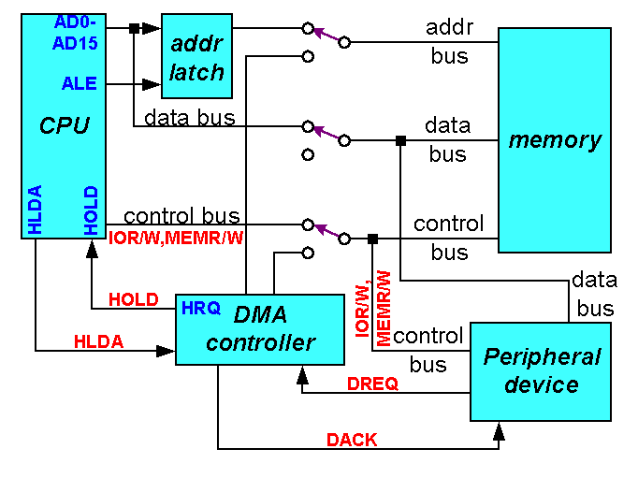
CPU having the control over the bus:

Slide 8

When DMA operates:

Slide 9
8257 DMA Controller

Slide 10
Features
It is a 4-channel DMA.
So 4 I/O devices can be interfaced to DMA
It is designed by Intel
Each channel have 16-bit address and 14 bit counter
It provides chip priority resolver that resolves priority of channels in fixed or rotating mode.
It provide on chip channel inhibit logic.
It generates a TC signal to indicate the peripheral that the programmed number of data bytes have been transferred.
The maximum frequency is 3Mhz and minimum frequency is 250 Hz.

Slide 11
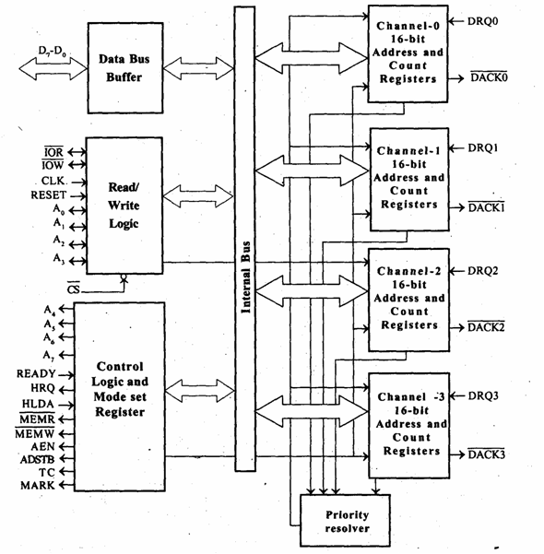
Block Diagram

Slide 12
D0-D7:
it is a bidirectional ,tri state ,Buffered ,Multiplexed data (D0-D7)and (A8-A15).
IOR:
It is active low ,tristate ,buffered ,Bidirectional lines.
IOW:
It is active low ,tristate ,buffered ,Bidirectional control lines.
CLK:
It is the input line ,connected with TTL clock generator
RESET:
Used to clear mode set registers and status registers
A0-A3:
A0-A3 bits of memory address on the lines.

Slide 13
READY:
It is a asynchronous input line.
In master mode,
When ready is high it is received the signal.
HRQ:
It is used to receiving the hold request signal from the output device.
HLDA:
It is acknowledgment signal from microprocessor.

Slide 14
AEN (Address enable):
It is a control output line.
Used it isolate the system address ,data ,and control lines.
ADSTB: (Address Strobe)
It is a control output line.
Used to split data and address line.
TC (Terminal Count):
It is a status of output line.
It is high ,it selected the peripheral.
It is low ,it free and looking for a new peripheral.
MARK:
It is a modulo 128 MARK output line.

Slide 15
DRQ0-DRQ3(DMA Request):
These are the asynchronous peripheral request input signal.
The request signals is generated by external peripheral device.
DACK0-DACK3:
These are the active low DMA acknowledge output lines.
Low level indicate that ,peripheral is selected for giving the information (DMA cycle).
In master mode it is used for chip select.
Control logic block:
It contains ,
Control logic
Mode set register and
Status Register.

Slide 16
MODE SET REGISTERS:
It is a write only registers.
It is used to set the operating modes.
This registers is programmed after initialization of DMA channel.
AL=1=Auto load mode
AL=0=Rotating mode
D₇ | D₆ | D₅ | D₄ | D₃ | D₂ | D₁ | D₀
AL | TCS | EW | RP | EN₃ | EN₂ | EN₁ | EN₀

Slide 17
TCS=1=Stop after TC (Disable Channel)
TCS=0=Start after TC (Enable Channel)
EW=1=Extended write mode
EW=0=normal mode.
RP=1=Rotating priority
RP=0=Fixed priority.
EN₃=1=Enable DMA CH-3
EN₃=0=Disable DMA CH-3
EN₂=1=Enable DMA CH-2
EN₂=0=Disable DMA CH-2
EN₁=1=Enable DMA CH-1
EN₁=0=Disable DMA CH-1
EN₀=1=Enable DMA CH-0
EN₀=0=Disable DMA CH-0

